Slide 1

Consumer_Electronics_Sales_Analysis_Prediction
By_TIRTC
DURGA PRASAD PAMPANA
ADIKAVI NANNAYA UNIVERSITY
COLLEGE OF ENGINEERING
AICTE STUDENTID STU6829b8957b2991747564693

Slide 2

PROBLEM STATEMENT
To analyze consumer electronics purchasing behavior using customer and product data, identify the key factors affecting purchase intent and customer satisfaction, and build a model to predict whether a customer is likely to purchase a product.
Key Focus:
Analyze customer and product trends
Identify factors influencing purchase intent
Understand customer satisfaction
Predict potential purchases using data
Goal: Help businesses make better sales, marketing, and customer-targeting decisions.

Slide 3
Project Description
This project analyzes consumer electronics sales and customer behavior using product and customer data. It explores factors such as product category, brand, price, customer age, gender, purchase frequency, and satisfaction to understand purchasing patterns.
The project also identifies the key factors affecting Purchase Intent and uses data analysis and machine learning to predict customer purchase behavior.
Tools: Python, Pandas, Matplotlib, Seaborn, Scikit-learn, Power BI

Slide 4

WHO ARE THE END USERS?
END USERS FOR THIS PROJECT:
Sales & Marketing Teams – Identify potential customers and improve marketing strategies.
Business Analysts – Analyze customer behavior and product trends.
Product Managers – Understand product and brand preferences.
E-commerce & Retail Businesses – Improve sales and customer targeting.
Business Managers – Make data-driven decisions and improve business performance

Slide 5

Technology Used
Python
Used as the primary programming language for data analysis and visualization.
Pandas
Used for data cleaning, preprocessing, filtering, grouping, and analysis.
NumPy
Used for numerical calculations and data manipulation.
Matplotlib
Used to create bar charts, line charts, scatter plots, histograms, and other visualizations.
Seaborn
Used to create advanced statistical visualizations, including boxplots, heatmaps, and categorical charts.
Google Colab
Used as the cloud-based coding and analysis environment for running Python code and performing the project analysis.

Slide 6
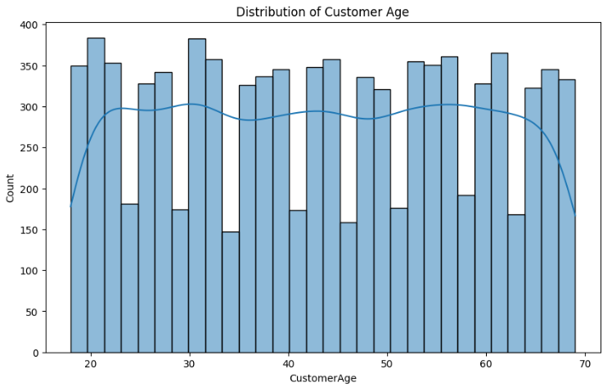
RESULTS
Demo Link

Slide 7
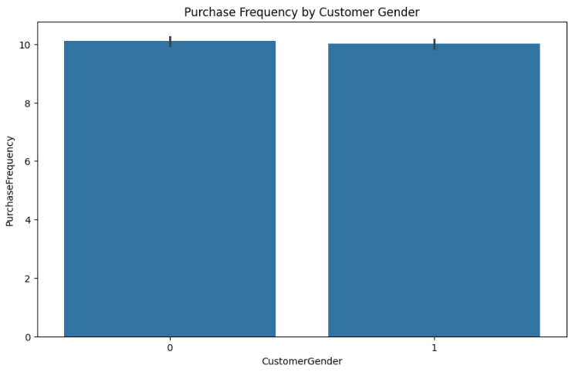
RESULTS
Demo Link

Slide 8
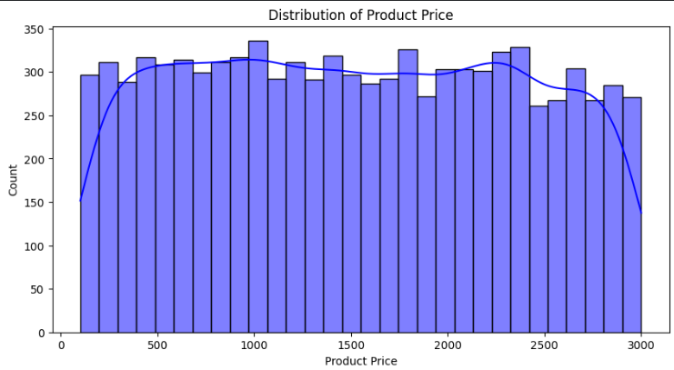
RESULTS
Demo Link

Slide 9
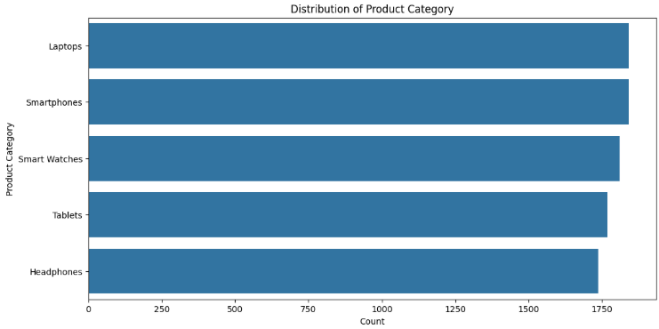
RESULTS
Demo Link

Slide 10
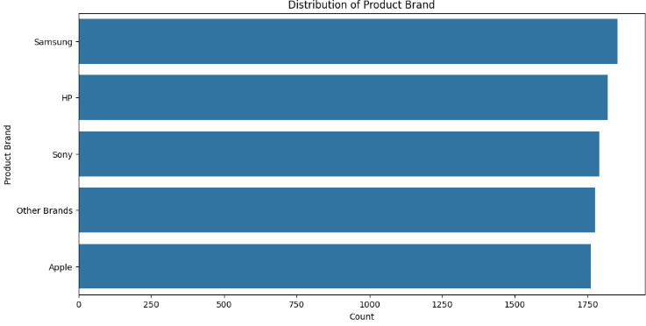
RESULTS
Demo Link

Slide 11
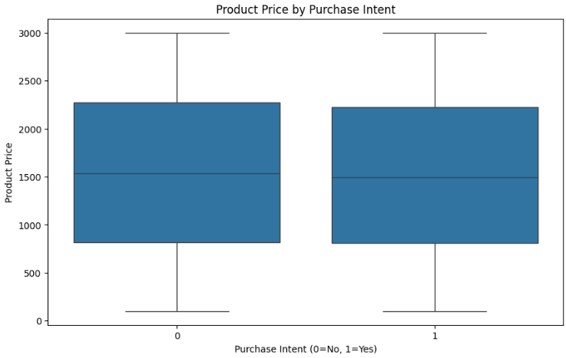
RESULTS
Demo Link

Slide 12
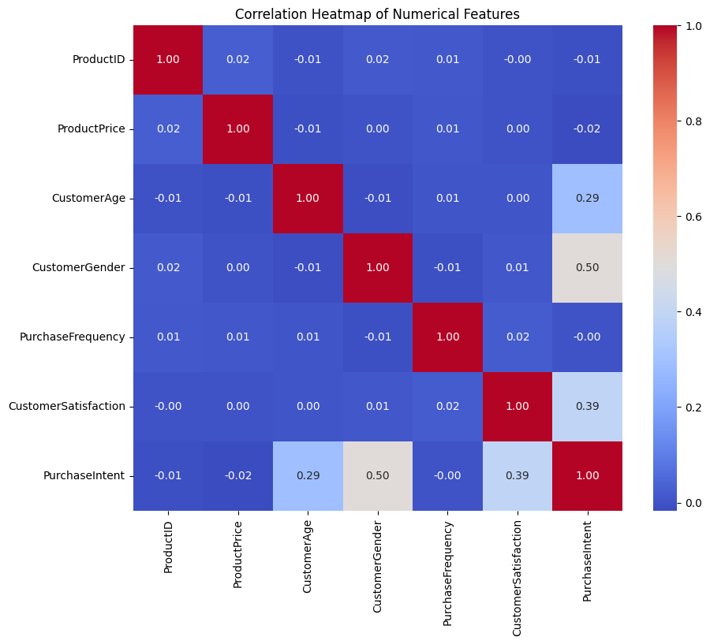
RESULTS
Demo Link

Slide 13
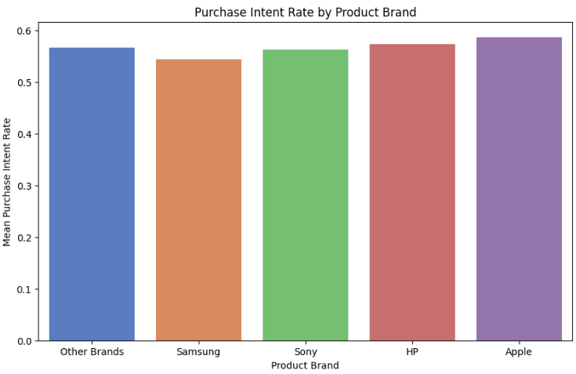
RESULTS
Demo Link

Slide 14
Thank you
.
.

